Slide 1


Slide 2
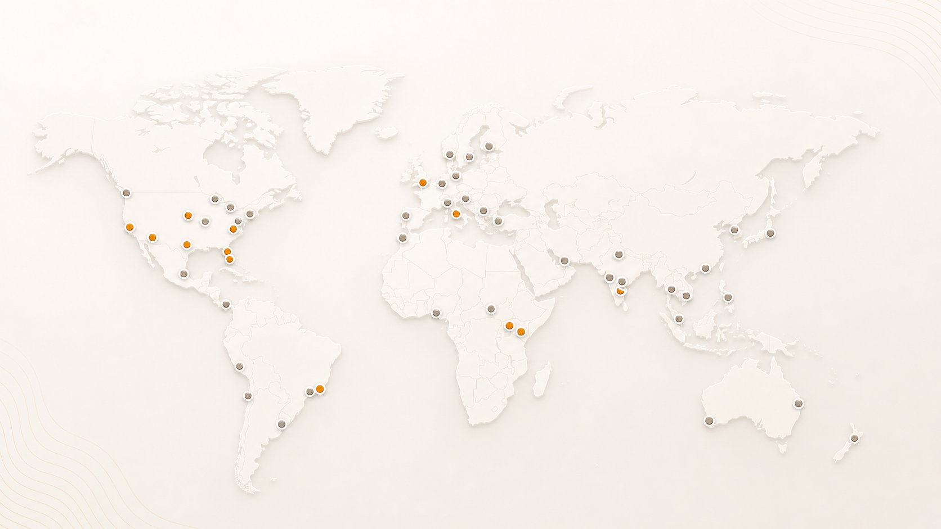
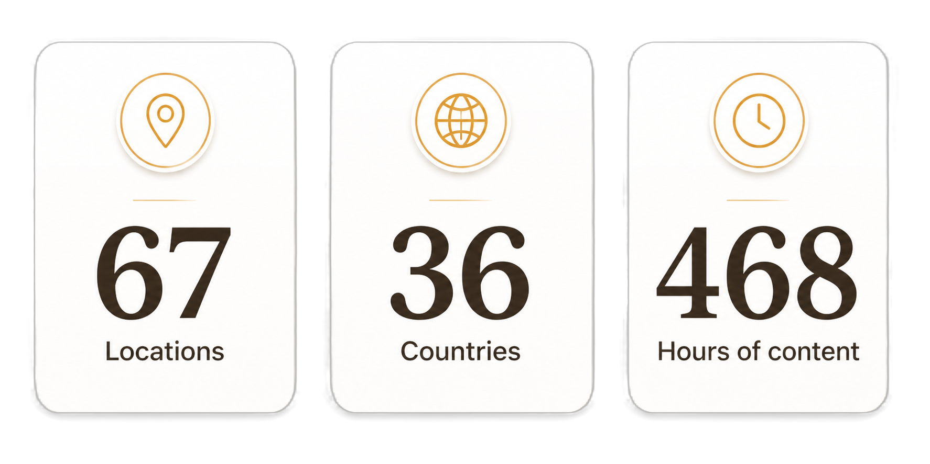
AgentCon around the world

Slide 3
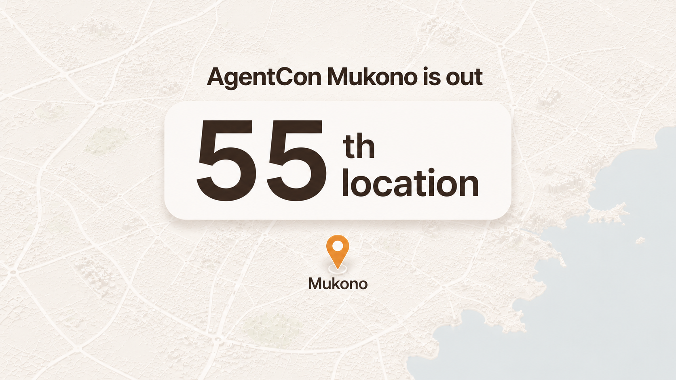

Slide 4


Slide 5
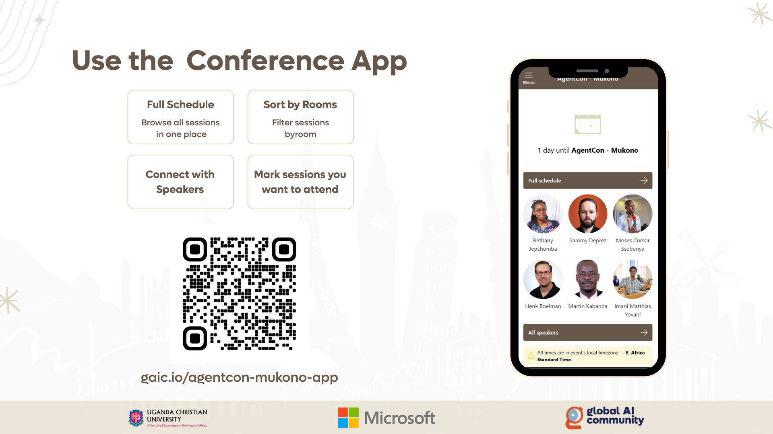

Slide 6
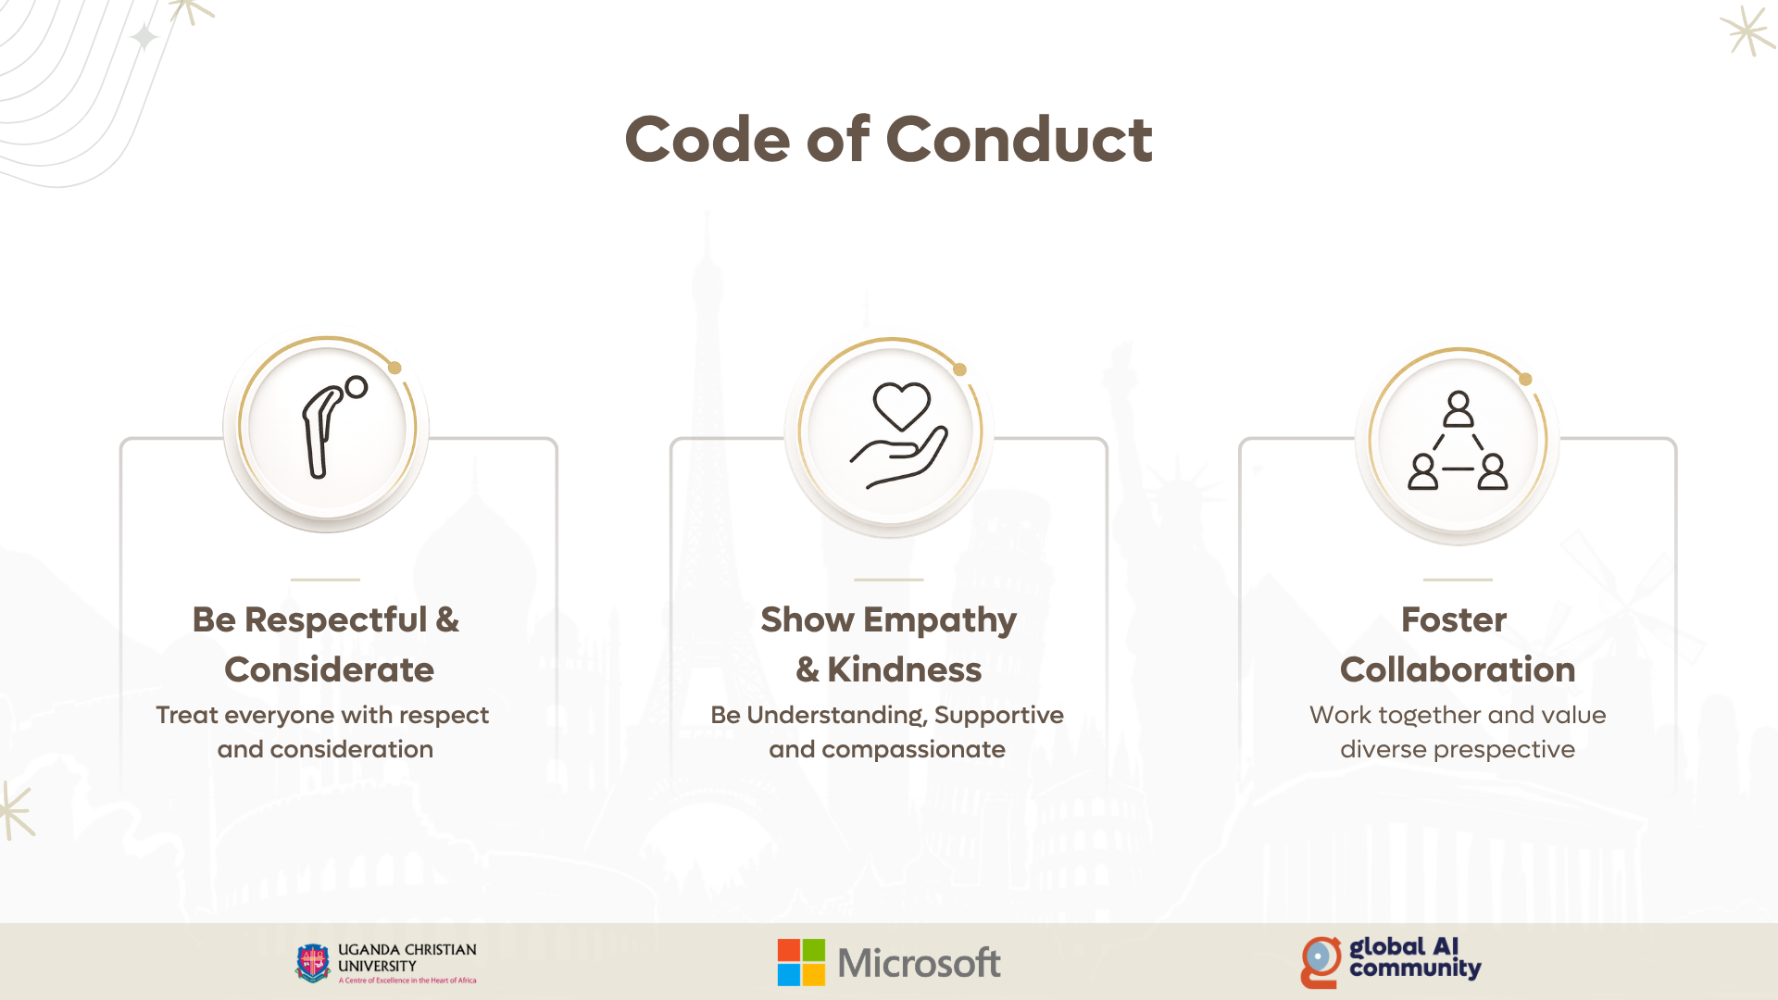

Slide 7
09:00 AM - 09:15 AM
Opening by UCU : Martin Kabanda
Keynote: Henk Boelman
Agents of Tomorrow: Building the Next Generation of Intelligence
09:15 AM - 10:10 AM
10:15 AM - 10:25 AM
Phalanx: Web based Intrusion Prevention
10:30 AM - 10:40 AM
Shared Autonomy for Personal Computing
10:45 AM – 11:25 AM
Bethany Jepchumba
Building your first Agent
11:30 AM – 11:40 AM
Using Design Thinking – Maximising AI Potential
11:45 AM – 11:55 AM
Agents Without Limits: Building Smarter
Apps with MCP
Sammy Deprez
Guardians of the Promptiverse: Ensuring LLM
Safety and Security
12:00 AM – 12:45 AM
12:45 PM – 01:15 PM
The Grand Closing:
Raffle & Community Quiz
01: 15 PM- 02:00 PM
Networking Lunch

Slide 8

Join the AI Conversation on Discord
gaic.io/discord

